Slide 1


How computer understands a words?
Abdul Kalam is a Great man
Elon Musk is Awesome
www.hopelearning.net
hope_artificial_intelligence
www.hopelearning.net
hope_artificial_intelligence

Slide 2
How computer understands a words?
Abdul
1
Elon
11
Kalam
22
Musk
12
is
13
is
13
a
4
Great
5
Awesome
19
man
6
www.hopelearning.net
hope_artificial_intelligence
www.hopelearning.net
hope_artificial_intelligence

Slide 3
Why is Word Embedding needed?
3
2
Elon
Musk
Awesome
1
a
is
Abdul
Great
man
Kalam
o
22
www.hopelearning.net
hope_artificial_intelligence
www.hopelearning.net
hope_artificial_intelligence

Slide 4

Why is Word Embedding needed?
3
2
Elon
Musk
Awesome
1
Great
man
is
Abdul
a
Kalam
o
22
www.hpelearning.net
hope_artificial_intelligence
www.hopelearning.net
hope_artificial_intelligence

Slide 5
Why is Word Embedding needed?
3
2
Elon
Musk
Awesome
1
Great
man
is
Abdul
a
Kalam
o
22
www.hopelearning.net
hope_artificial_intelligence
www.hopelearning.net
hope_artificial_intelligence

Slide 6


Why is Word Embedding needed?
3
Musk
2
Elon
Awesome
Kalam
1
man
is
Abdul
Great
a
o
22
www.hopelearning.net
hope_artificial_intelligence
www.hopelearning.net
hope_artificial_intelligence

Slide 7



Why is Word Embedding needed?
RBG
Detailed description in the Deep Learning Module
www.hopelearning.net
hope_artificial_intelligence
www.hopelearning.net
hope_artificial_intelligence

Slide 8
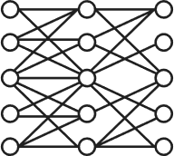
Word Embeddings using Neural Network
Using Neural Network
We can create meaningful numbers
www.hopelearning.net
hope_artificial_intelligence
www.hopelearning.net
hope_artificial_intelligence

Slide 9



Word Emebedding-Word2Vec
Two Strategies
Continuous Bag of words
(CBOW)
Skip Grams
www.hopelearning.net
hope_artificial_intelligence
www.hopelearning.net
hope_artificial_intelligence

Slide 10
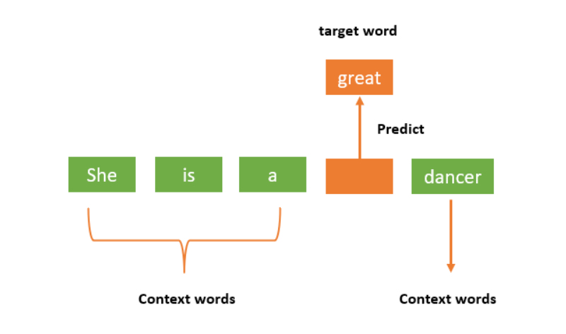
Word Emebedding-Word2Vec-CBOW
www.hopelearning.net
hope_artificial_intelligence
www.hopelearning.net
hope_artificial_intelligence

Slide 11
Word Emebedding-Word2Vec-CBOW
Continuous Bag of words
(CBOW)
The quick brown fox jumps over the lazy dog
Context Word, Target Word, Window Size
Context Word: (-2,Traget Word,+2)
www.hopelearning.net
hope_artificial_intelligence
www.hopelearning.net
hope_artificial_intelligence

Slide 12
Word Emebedding-Word2Vec-CBOW
The quick brown fox jumps over the lazy dog
(-2)
(-1)
(T)
(1)
(2)
Window 1:
Context words (‘N/A’,’N/A’, quick, brown) -
Target word ('The')
www.hopelearning.net
hope_artificial_intelligence
www.hopelearning.net
hope_artificial_intelligence

Slide 13
Word Emebedding-Word2Vec-CBOW
The quick brown fox jumps over the lazy dog
(-2)
(-1)
(T)
(1)
(2)
Window 2:
Context words (‘N/A’, ’The’, ‘brown’,’fox’) -
Target word (‘quick')
www.hopelearning.net
hope_artificial_intelligence
www.hopelearning.net
hope_artificial_intelligence

Slide 14
Word Emebedding-Word2Vec-CBOW
The quick brown fox jumps over the lazy dog
(-2)
(-1)
(T)
(1)
(2)
Window 3:
Context words ( ’The’, ‘quick’, ’fox’,jumps) -
Target word (‘brown’)
www.hopelearning.net
hope_artificial_intelligence
www.hopelearning.net
hope_artificial_intelligence

Slide 15
Word Emebedding-Word2Vec-CBOW
The quick brown fox jumps over the lazy dog
(-2)
(-1)
(T)
(1)
(2)
Window 3:
Context words ( ’The’, ‘quick’, ’fox’,jumps) -
Target word (‘brown’)
www.hopelearning.net
hope_artificial_intelligence
www.hopelearning.net
hope_artificial_intelligence

Slide 16
Word Emebedding-Word2Vec-CBOW
The quick brown fox jumps over the lazy dog
(-2)
(-1)
(T)
(1)
(2)
Window 4 :
Context words ( ‘quick’,’Brown’ ,’jumps,’over) -
Target word (‘fox’)
www.hopelearning.net
hope_artificial_intelligence
www.hopelearning.net
hope_artificial_intelligence

Slide 17
Word Emebedding-Word2Vec-CBOW
The quick brown fox jumps over the lazy dog
(-2)
(-1)
(T)
(1)
(2)
Window 4 :
Context words ( ‘quick’,’Brown’ ,’jumps,’over) -
Target word (‘fox’)
www.hopelearning.net
hope_artificial_intelligence
www.hopelearning.net
hope_artificial_intelligence

Slide 18
Word Emebedding-Word2Vec-CBOW
Input
Output
Input
Output
N/A,N/A, quick, brown
The
N/A, The, brown, fox
quick
The, quick, fox, jumps
brown
www.hopelearning.net
hope_artificial_intelligence
www.hopelearning.net
hope_artificial_intelligence

Slide 19
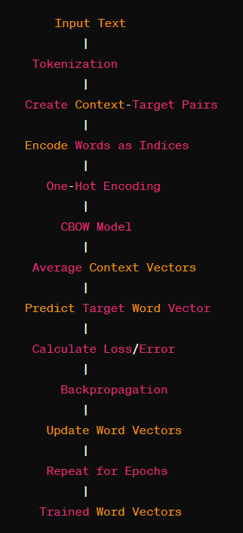
Word Emebedding-Word2Vec-CBOW
www.hopelearning.net
hope_artificial_intelligence
www.hopelearning.net
hope_artificial_intelligence

Slide 20
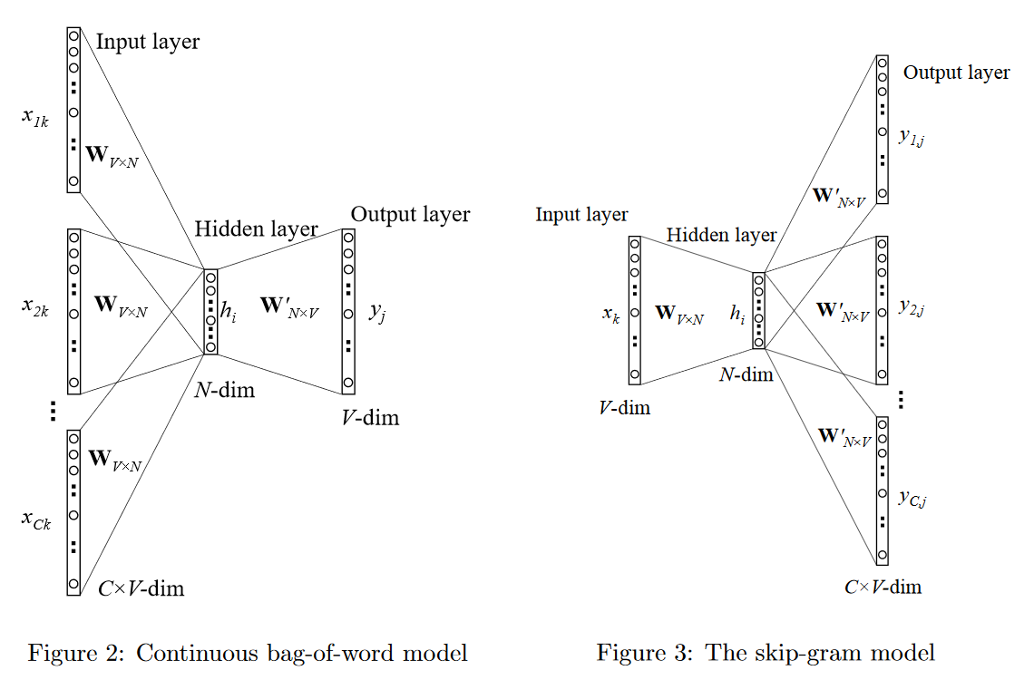
Word Emebedding-Word2Vec-CBOW
www.hopelearning.net
hope_artificial_intelligence
www.hopelearning.net
hope_artificial_intelligence

Slide 21
Word Emebedding-Word2Vec-Skip Gram
Input
Output
input
Output
The
N/A,N/A, quick, brown
quick
N/A, The, brown, fox
brown
The, quick, fox, jumps
www.hopelearning.net
hope_artificial_intelligence
www.hopelearning.net
hope_artificial_intelligence

Slide 22
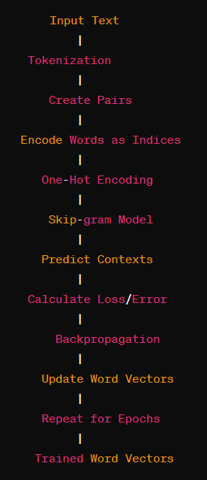
Word Emebedding-Word2Vec-Skip Gram
www.hopelearning.net
hope_artificial_intelligence
www.hopelearning.net
hope_artificial_intelligence

Slide 23
Word Emebedding-Word2Vec-Skip Gram
www.hopelearning.net
hope_artificial_intelligence
www.hopelearning.net
hope_artificial_intelligence

